Slide 1


MODULE 3: PROGRAMMING FOR BIOLOGICAL DATA
Session 2: The Data Frame & Digital Sample Management
Moving from Single Tubes (Vectors) to Master Worksheets
Instructor: Dr. Gu Haogao
January 7, 2026

Slide 2
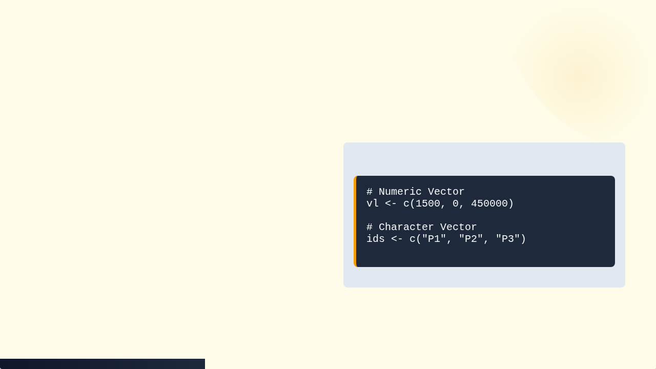

Recap: The Vector (Single Tube)
Concept: A sequence of data points of the same type.
Great for: Batch processing a single list of numbers (e.g., QC values, Ct scores).
The Flaw: You cannot mix text (Patient ID) and numbers (Viral Load) in the same vector.

Slide 3






The Danger of Loose Vectors
What happens if you sort one vector but forget to sort the others?
Sample Swap
Disconnected Data
Clinical Error
Patient P1 gets P2's diagnosis.
Vectors have no inherent link to each other.
High risk in diagnostics.

Slide 4

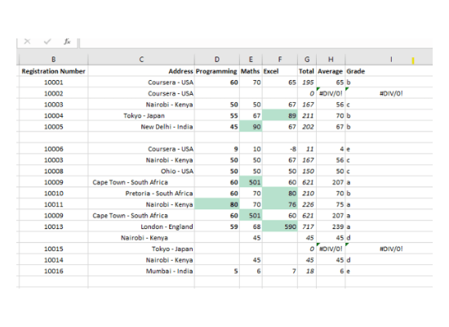
The Solution: The Data Frame
A Data Frame is the R equivalent of an Excel Worksheet or a Lab Bench Log.
It glues vectors together.
It enforces that rows stay together.
It allows mixed data types (Text columns + Numeric columns).

Slide 5


Anatomy of a Data Frame
Rows (Observations)
Columns (Variables)
Each row represents a single Patient or Sample.
Each column is a Vector.
Each column must contain only one data type (e.g., Age is numeric, Gender is text).
If you filter a row, all data for that patient moves together.

Slide 6
Visualizing the Structure
Patient_ID (Chr) | Age (Num) | Gender (Chr) | Viral_Load (Num)
P001 | 45 | M | 15000
P002 | 32 | F | 0
P003 | 58 | F | 450000
This looks like Excel, but it is a programmable object in R.

Slide 7

Concept 2: The "Read-Only" Principle
Excel Risk: You open a file, accidentally delete a cell, and hit "Save". The original clinical data is corrupted forever.
R Safety: You "Read" the file into R's memory. The original CSV on your hard drive is never touched.
Audit Trail: Any changes happen in code, not on the original file.

Slide 8
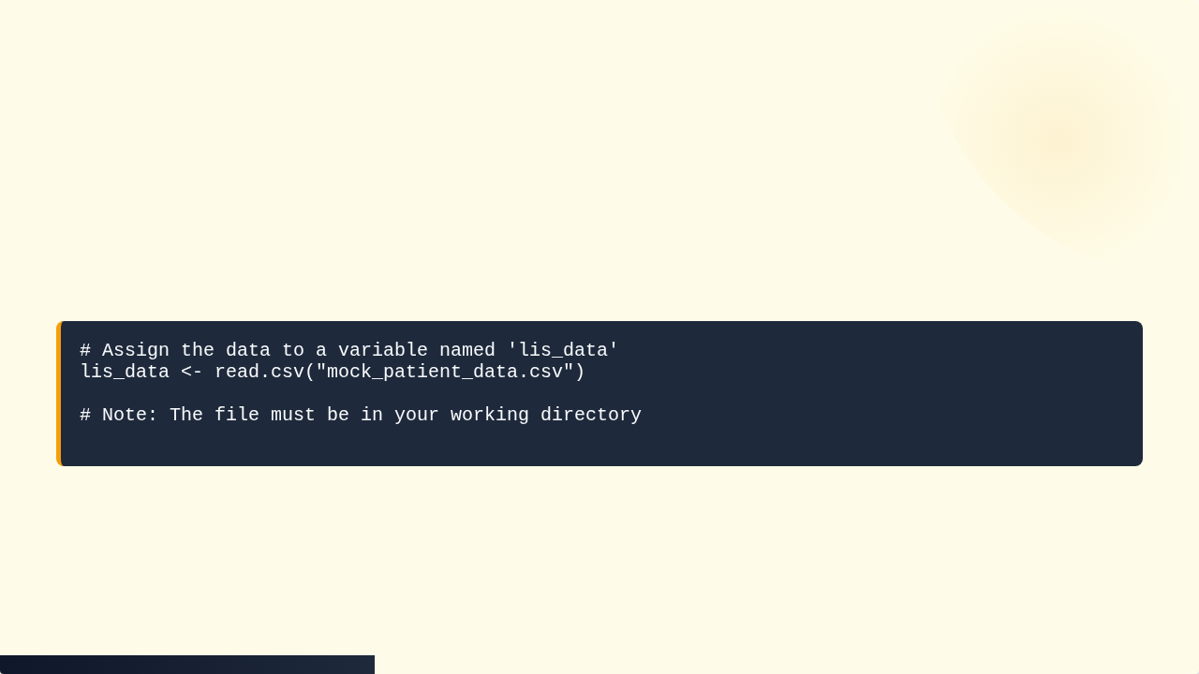
Reading Data: Sample Reception
The read.csv() function is your sample intake window.
This creates a Data Frame object in R's environment.

Slide 9




Inspecting the Manifest
Always check your data immediately after loading.
head(data)
dim(data)
Shows the first 6 rows. Checks headers and formatting.
Shows dimensions (Rows x Columns). Did we receive all 100 samples?

Slide 10
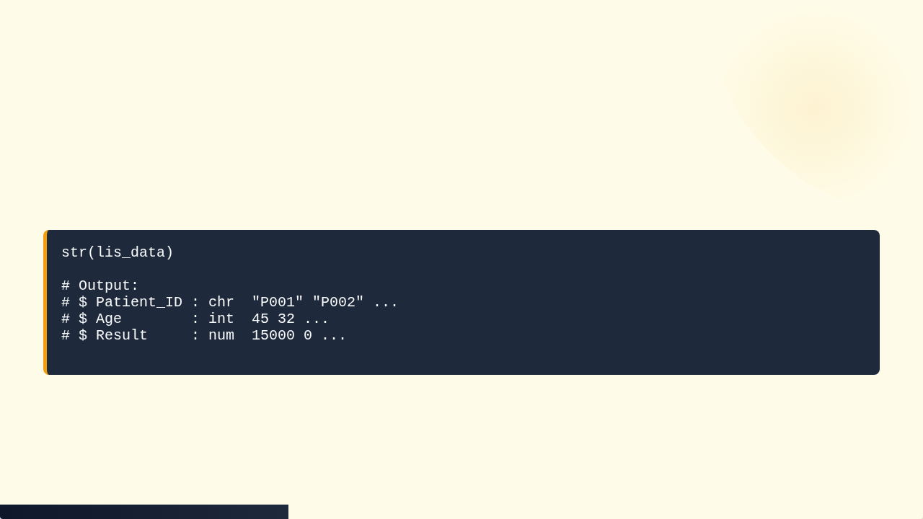
The MRI Scan: str()
str() stands for Structure. It reveals the data types of every column.
Crucial Check: Ensure your numeric results are actually labeled as int or num, not chr.

Slide 11


Concept 3: The Coordinate System
To find data in a Data Frame, we use coordinates, just like a 96-well plate.
data[Row, Column]
Example: data[1, 2] gets the value at Row 1, Column 2.

Slide 12
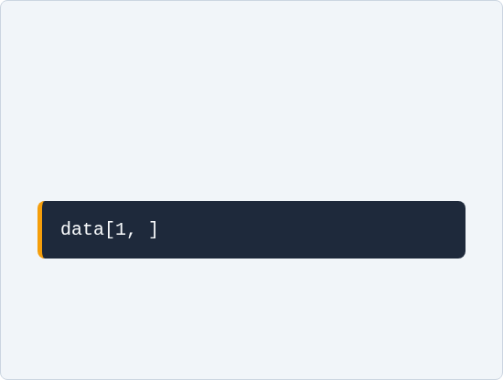
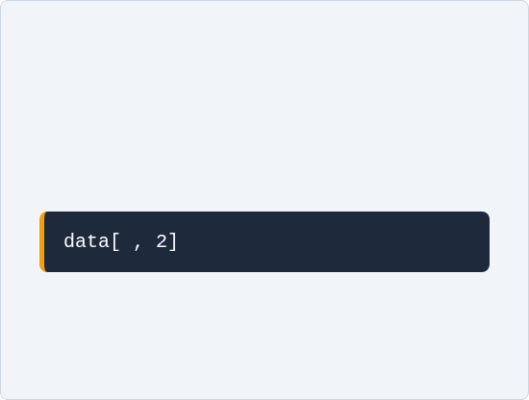
Indexing: Slicing the Plate
Get a Row
Get a Column
Leave the column coordinate blank to get all columns.
Leave the row coordinate blank to get all rows.
(Pulling one patient's full file)
(Pulling the 'Age' vector for the batch)

Slide 13
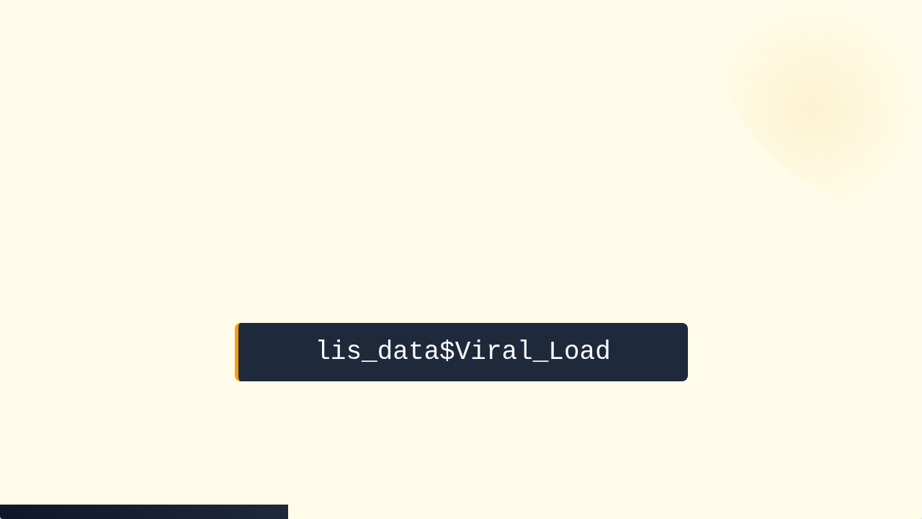

The Dollar Sign $
The "Quick Grab" Operator
Instead of memorizing column numbers, grab them by name.

Slide 14
Practice: Basic Stats on Frames
Now we can combine the $ operator with the functions we learned in Session 1.
Calculate Average Age:
mean(lis_data$Age)
Find Max Viral Load:
max(lis_data$Viral_Load)
Summary of all columns:
summary(lis_data)

Slide 15

Concept 4: Logical Subsetting (The Filter)
We rarely analyze all patients. We usually want a specific subgroup (e.g., "Positives" only).
The Logic: "Select all rows WHERE Status is Positive".
This creates a reproducible filter, unlike manually hiding rows in Excel.

Slide 16
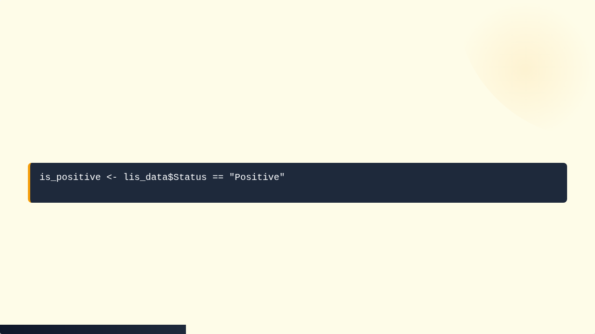


Step 1: Creating the Mask
First, we ask R a Question. This creates a logical vector of TRUE/FALSE.
"Keep" vs "Discard"

Slide 17
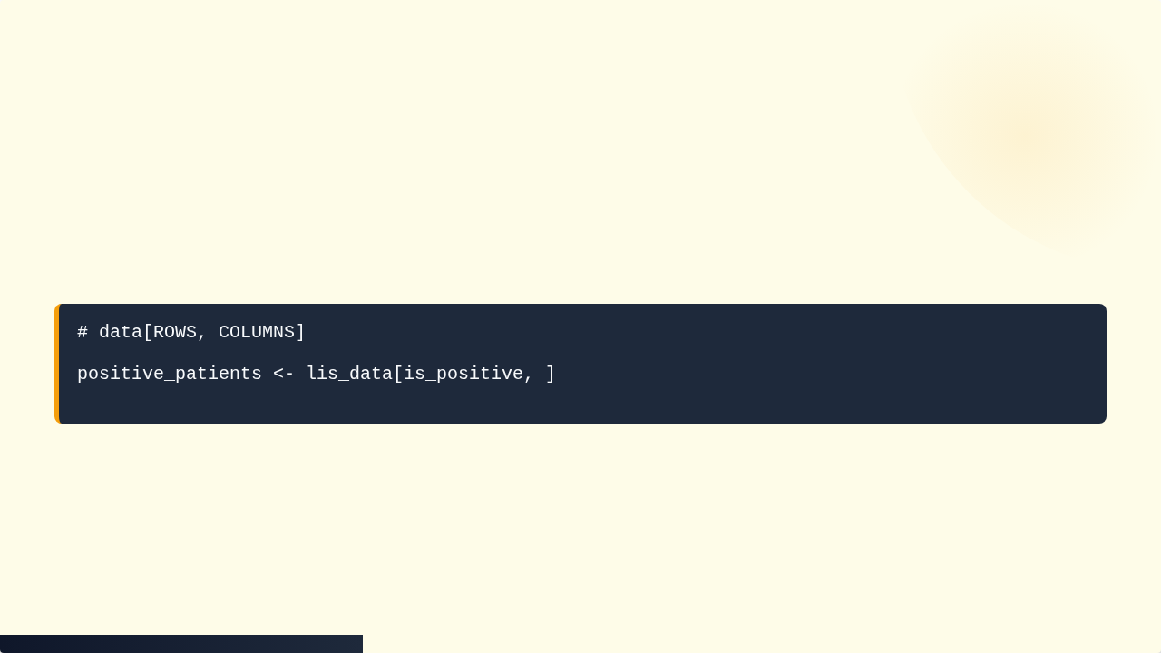
Step 2: Applying the Mask
We put the mask inside the row coordinate of the brackets.
Note the comma! We leave the column coordinate blank because we want to keep all columns for the positive patients.

Slide 18
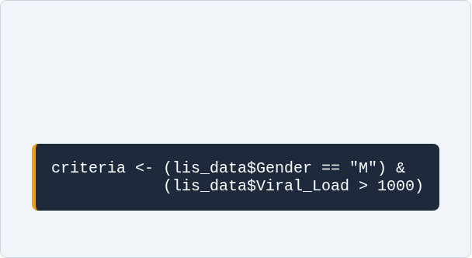
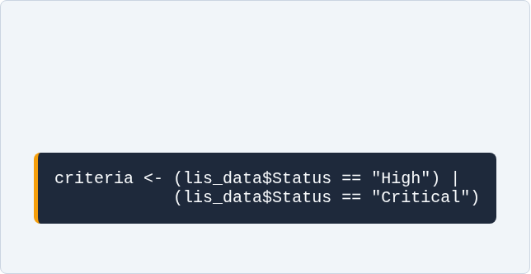
Complex Logic (AND / OR)
AND (&)
OR (|)
Both conditions must be TRUE.
At least one condition is TRUE.

Slide 19
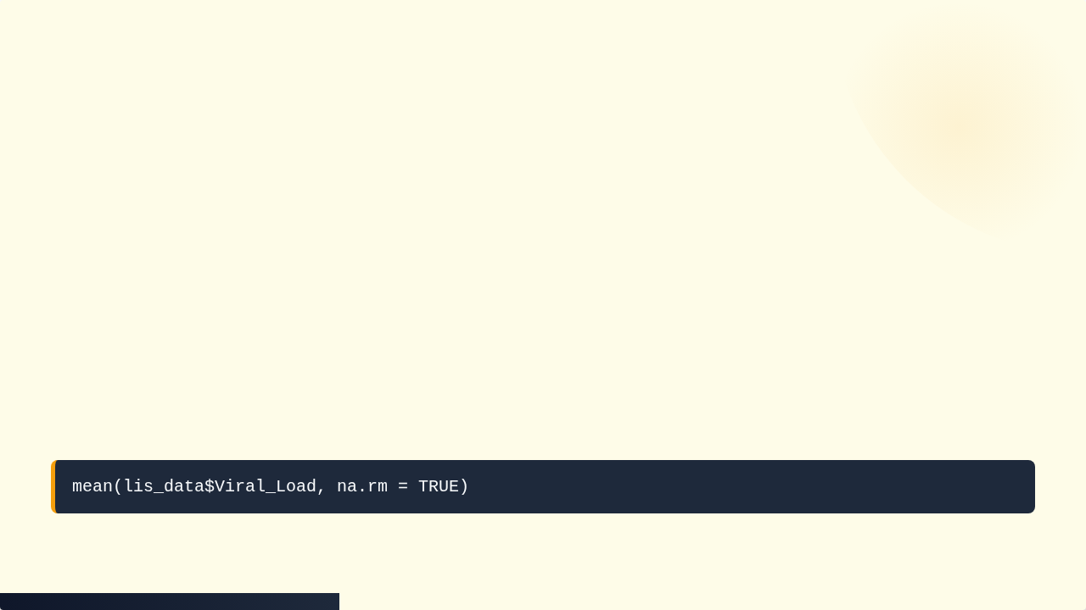

Handling Missing Data (NA)
The Broken Tube
If a vector contains NA, math functions will return NA by default.
mean(c(10, 20, NA)) -> NA
The Fix: Tell the function to remove NAs.

Slide 20
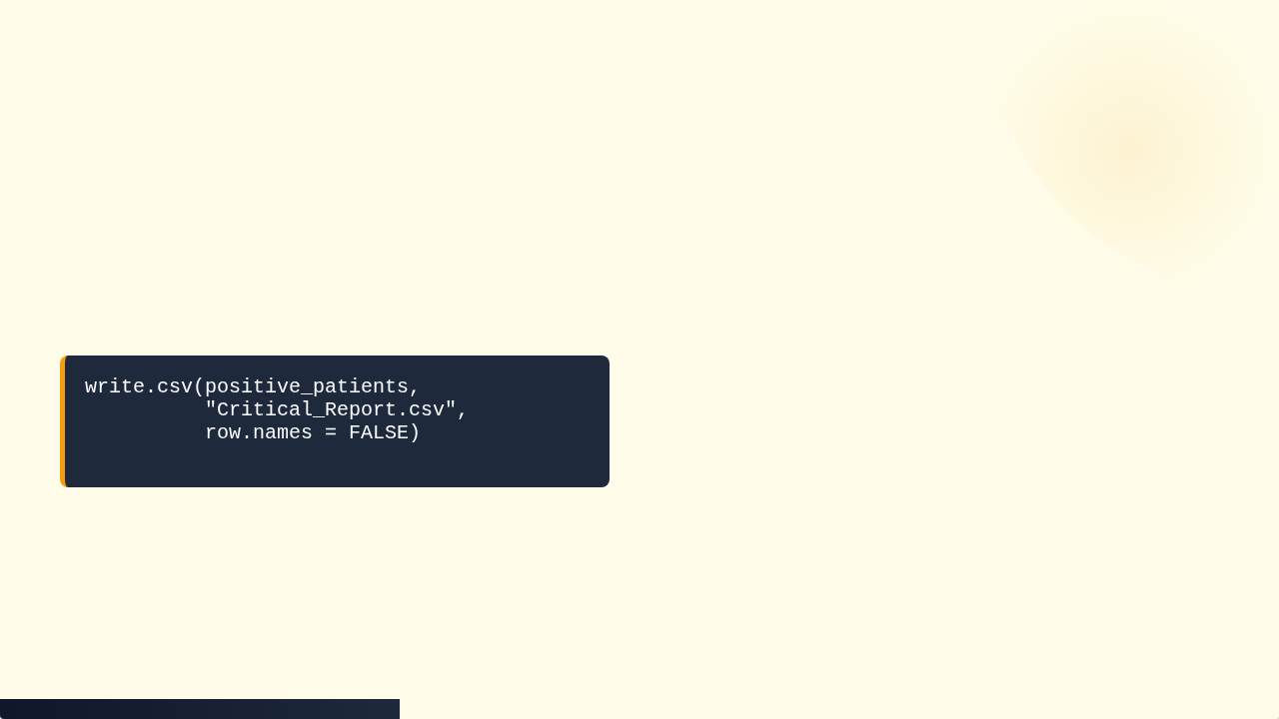

Concept 5: Writing Data (Output)
Once you have filtered the "Critical" patients, you need to send a list to the doctor.
This creates a new CSV file. The raw data remains untouched.

Slide 21
Session 2 Summary
read.csv(): Import data from a file.
head() / str(): Inspect data structure.
$: Select a column by name.
[Row, Col]: Select by coordinates.
data[mask, ]: Filter rows using logic.
write.csv(): Export results to a file.

Slide 22

Tutorial 2: The LIS Clean-Up
Goal: Import a messy LIS dump, fix data type errors, filter for critical female patients, and export a report.
1. Import from URL
2. Clean Data Types
3. Logical Filtering

Slide 23
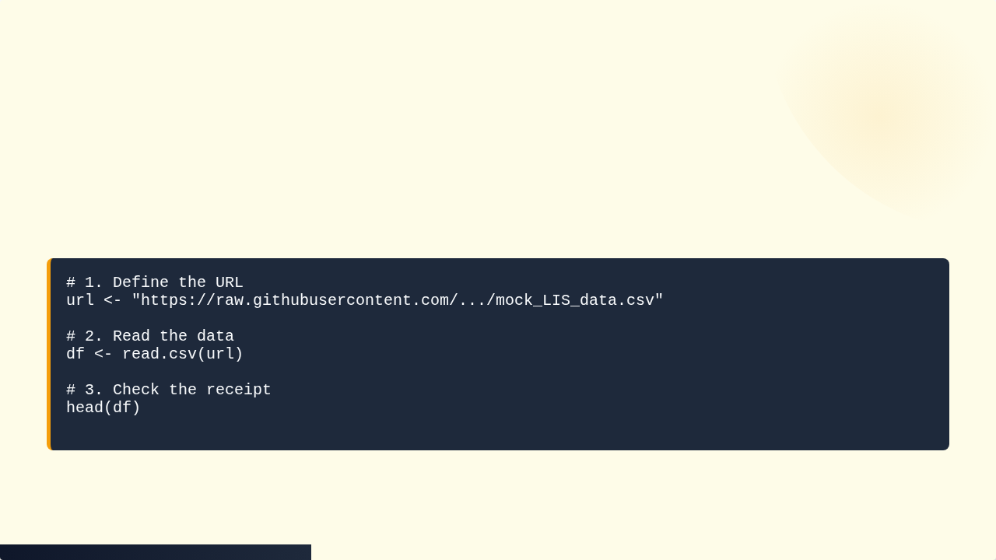
Step 1: Load the Data
We will read the raw data directly from the GitHub repository.

Slide 24
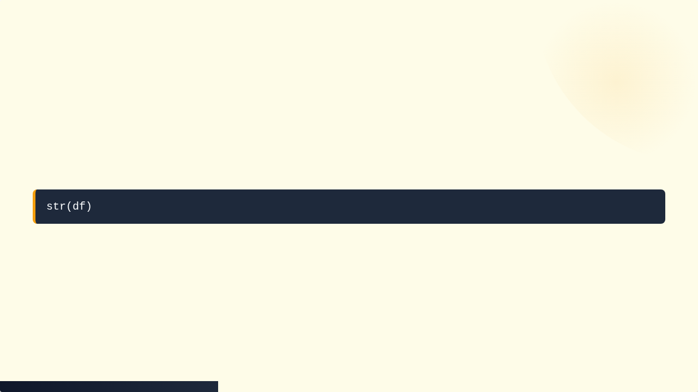
Step 2: The Inspection
Run the MRI scan on your data.
Observation: Look at the Result_Value column. Does it say chr or num?
If it says chr, it means someone typed text (e.g., "Error") into a number column.

Slide 25


Step 3: Data Cleaning (Coercion)
We need to force the column to be numeric.
This is good! It means R turned the text "Error" into NA.

Slide 26
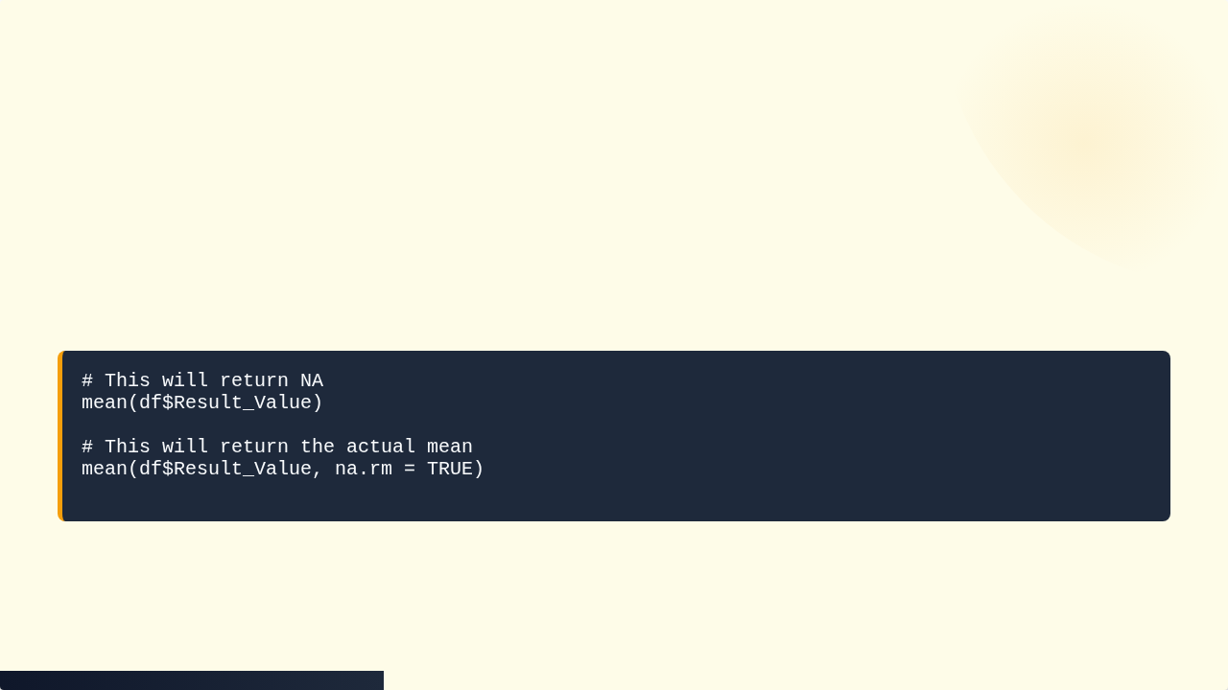
Step 4: Stats with NAs
Calculate the mean Result Value. Don't forget to handle the new NAs.

Slide 27
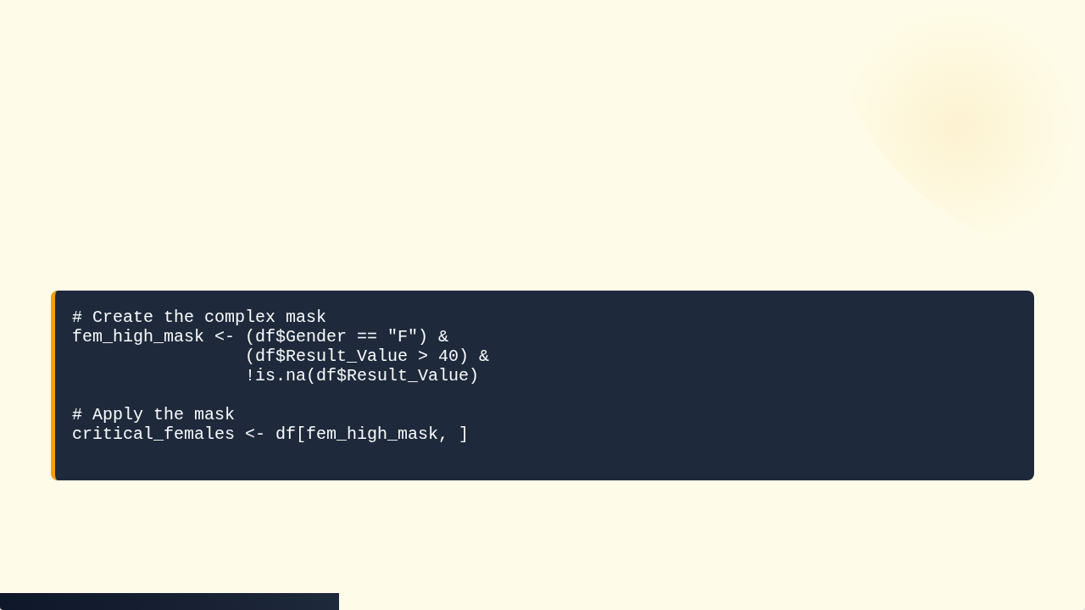
Step 5: Complex Filtering
We want: Female AND High Result (>40) AND Not NA.

Slide 28
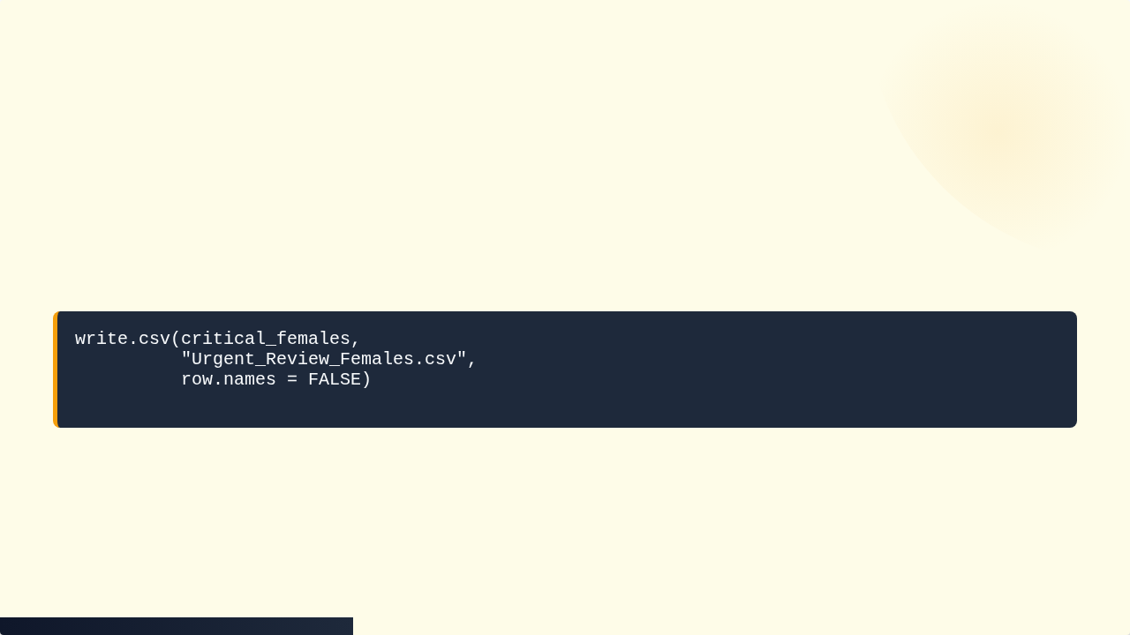
Step 6: Export
Save your work to a clean CSV file.
Check your file pane to see the new report!

Slide 29


https://github.com/Koohoko/MSc_Module3_Programming_BioData_HKUSpacce_2026

